Slide 1
FINAL
PRESENTATION
Anthony Le’Count • Camille Bouchard Alireza Jadidi • Haroun Benmeddour Jeel Patel • Phung An Vuong

Slide 2
AGENDA
Project Info
Background
Design Plan
Final Design
Work Accomplished
Testing
Challenges
Recommendations

Slide 3
PROJECT INFO

Slide 4

Project Info
Online bridal clothing store
Client: Abby
Owner of Never Knew I Needed (NKIN)
Based on NKIN’s functionality and design
Ongoing project from previous implementations
New features to be added/fixed

Slide 5

Project Info
Needs
Color customization: Adding and removing
Drag and drop feature for logo placement, Resize and Movement
Front page with multiple Items
Notes section
Limit Quantity options
Cart Checkout
Email Notification upon submitting

Slide 6
BACKGROUND

Slide 7

Background
Never Knew I needed, an Online Bridal Clothing Store
Features to improve Customer Experience
Completion of Previous teams work

Slide 8
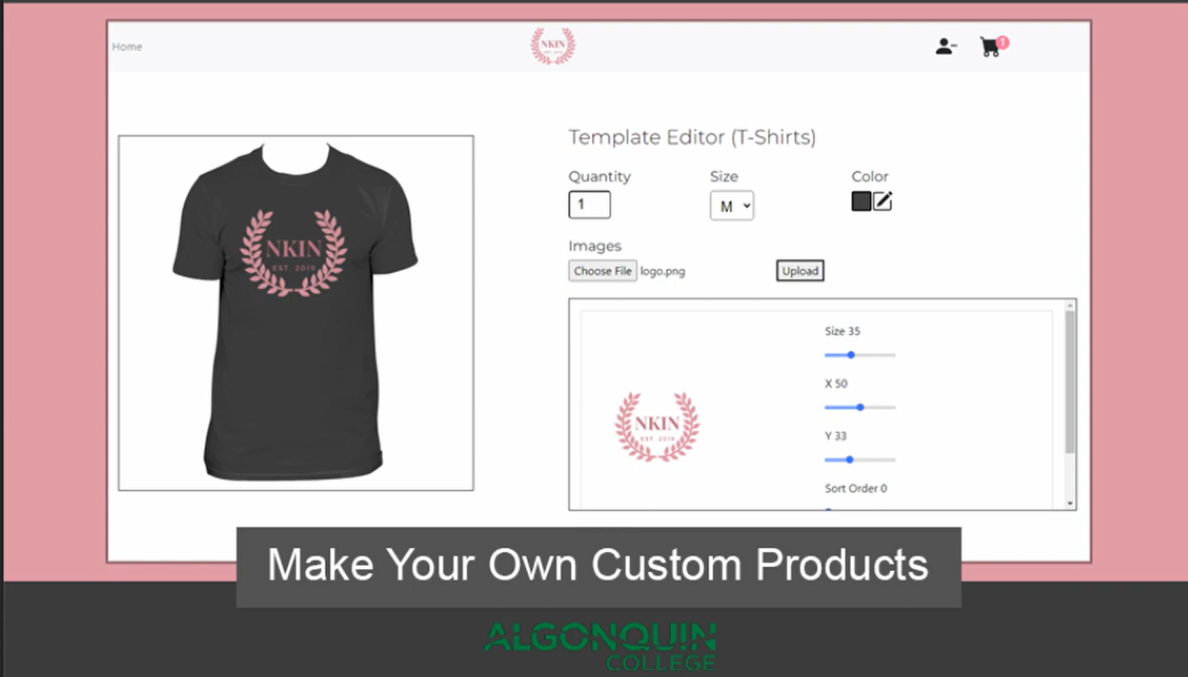
Previous Solution
Image upload
Color, Size & Quantity Options
Login system
Checkout

Slide 9
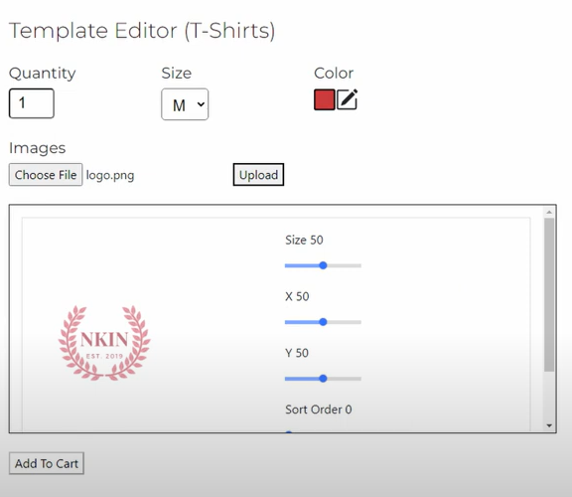
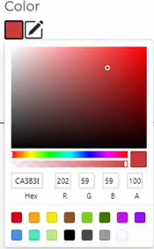
Previous Solution
Too many Color Options
Quantity Has no limit
Image Navigation Issues

Slide 10
DESIGN PLAN

Slide 11

Design Plan
Idea Comparison
Different frameworks
Layouts and Structure
Component Types

Slide 12

Design Choices
Local VS project
Node.Js
React.Js
JavaScript
Horizontal Layout
Reactive and modular for mobile
Industry standard
Buttons
Aesthetic
Easier to use

Slide 13
FINAL DESIGN

Slide 14

Final Design
Platform
Local VS Project
React for front end
Node stores color and data
Basic IDE Tools
Self determines framework

Slide 15
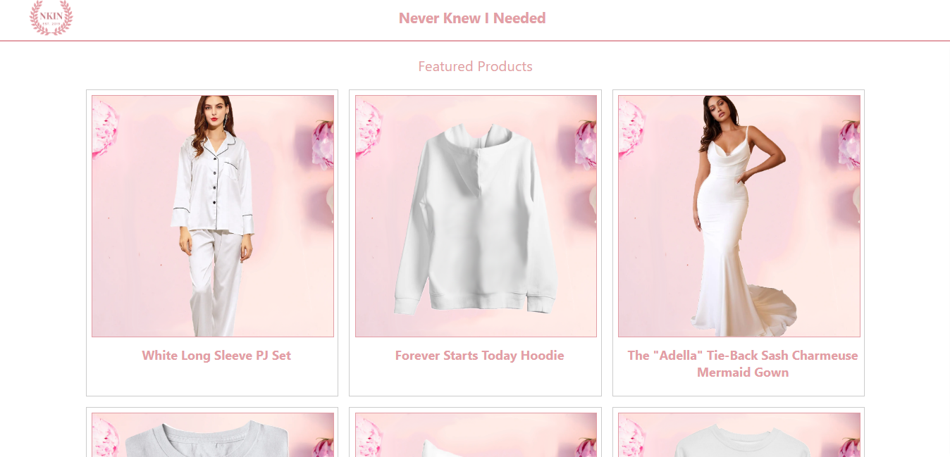
Final Design
Front Page
Product Selection
Choose desired product from table
Routing
Selected product for customization
Routing by product ID
ID used in link

Slide 16
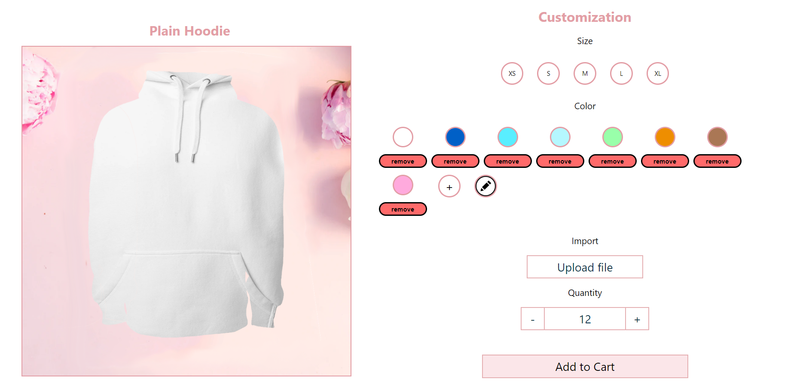
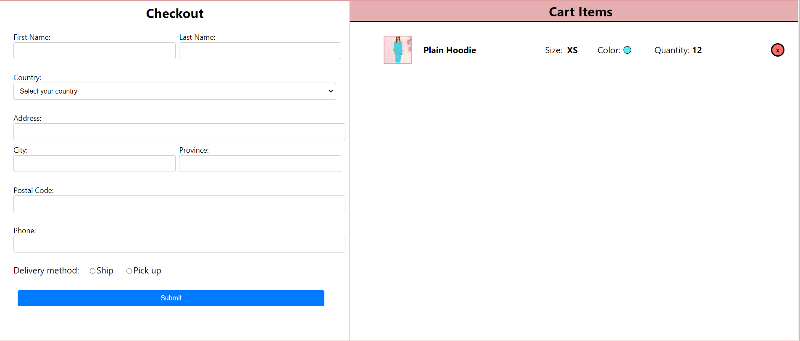
Final Design
Layout
Product view and controls on 1 page
Horizontal placement of checkout and cart
Intuitive and easy to use buttons diplayed
Center alignment for visual appeal

Slide 17
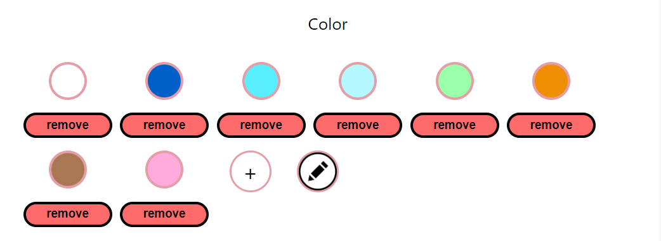
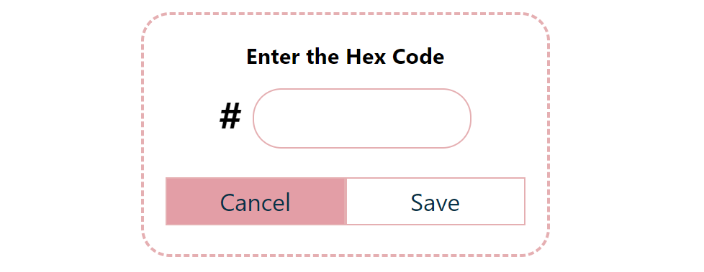
Final Design
Inputs
Custom color addition
Click “+” button to open the dropdown to enter hex code
Enter hex code of your desired color in the input field.
Click“save” and it will show with other colors.
When pressing remove button it removes color from the list

Slide 18
WORK ACCOMPLISHED

Slide 19

Work Accomplished
Front page
Product selection and routing
Image can be imported onto a t-shirt
Implemented drag and drop feature
Notes Section
Customer notes sent to cart
Color Buttons
Add colors using hex code and remove colors
Shirt Background color

Slide 20

Work Accomplished
Quantity features
Buttons to identify clothing size
Add to Cart Feature
Checkout
Entered customer info sent to email address
Server
Data storage using Node.js

Slide 21
TESTING

Slide 22
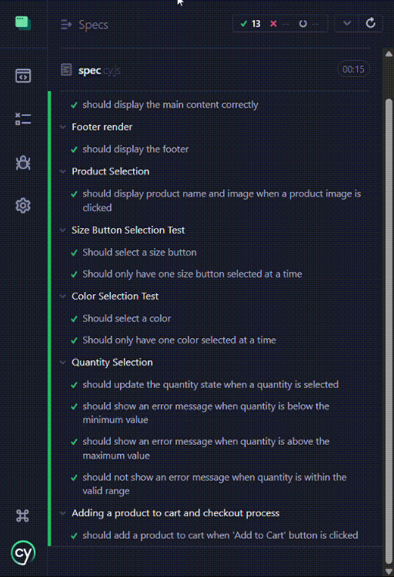
TESTING
Team
JEST
Automated Testing
Components testing
Sever Testing
CYPRESS
Automated Testing for components
E2E testing for the whole app
MANUAL
Testing Components
Functions/Scope testing

Slide 23
CHALLENGES

Slide 24

Challenges
React / Node
UI Design
Data Storage and lasting
Hosting limitations
Integrating all components
Testing & fixing features

Slide 25

Challenges
Team
Clarity
Time management
Communication among team members
Coordination or meeting scheduling

Slide 26
RECOMMENDATIONS

Slide 27

Recommendations
Login System
Mobile Integration
Browser and OS compatibility
Scalability for user traffic
Shopify Integration

Slide 28
DEMONSTRATION

Slide 29
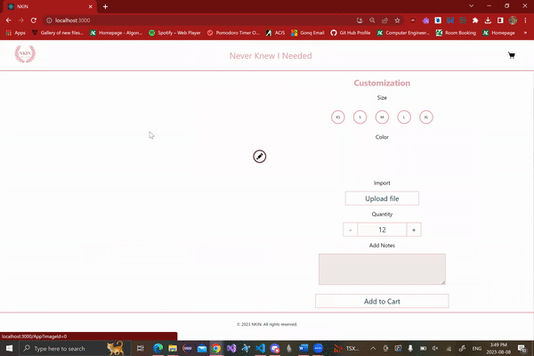
Screen Change

Slide 30
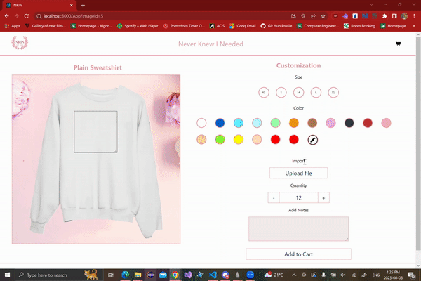
Image Import - Button

Slide 31
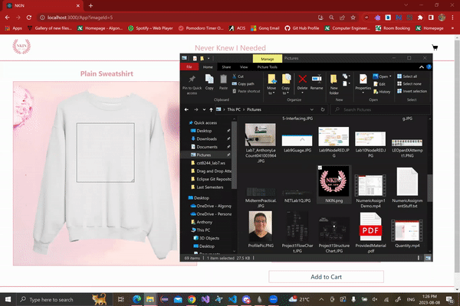
Image Import - Drag & Drop

Slide 32
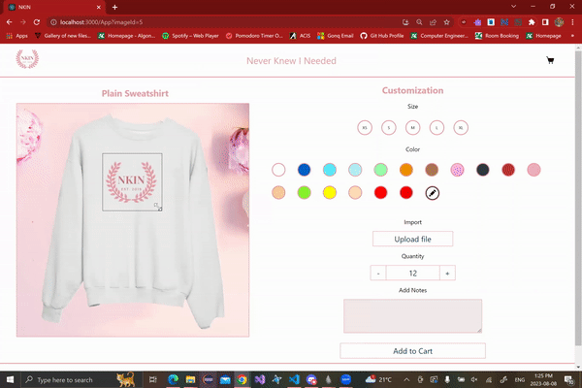
Image Resizing

Slide 33
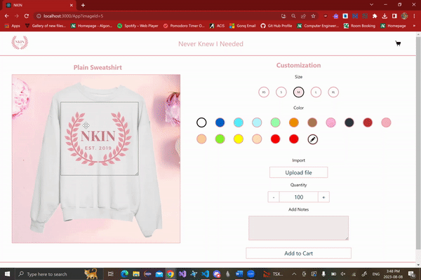
Image Movement

Slide 34
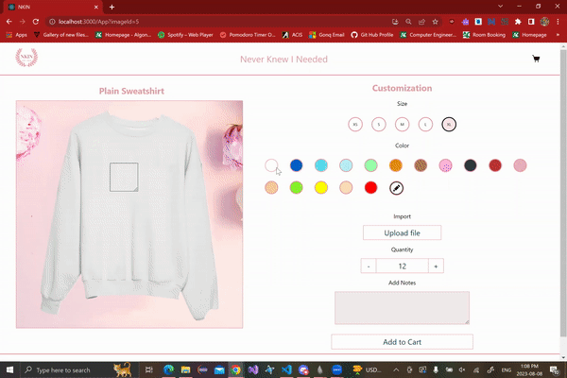
Colour Selection

Slide 35
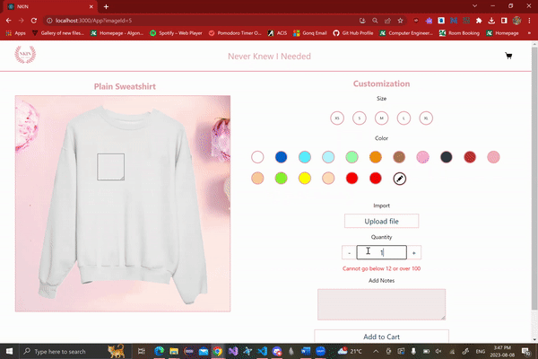
Quantity Modifier

Slide 36

Size Selection

Slide 37
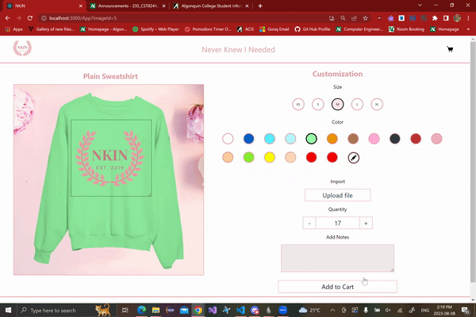
Add to Cart

Slide 38
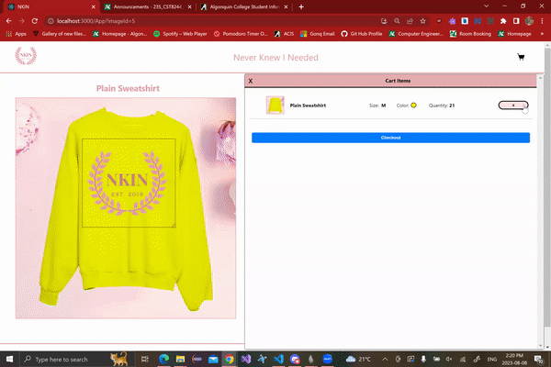
Checkout

Slide 39
References
“EzMoney - reaction,” YouTube, 29-Jul-2022. [Online]. Available:
https://www.youtube.com/watch?v=PlWtXOBiluQ&t=4s. [Accessed: 13-Apr-2023].
“Chat.openai.com.” [Online]. Available: https://chat.openai.com/. [Accessed: 13-Apr2023].
“Become a Shopify partner today - Shopify Partners,” Shopify. [Online]. Available: https://www.shopify.com/ca/partners. [Accessed: 13-Apr-2023].
“Shopify API reference docs,” Shopify. [Online]. Available: https://shopify.dev/docs/api. [Accessed: 13-Apr-2023].
“Web technology for developers,” MDN. [Online]. Available: https://developer.mozilla.org/en-US/docs/Web. [Accessed: 13-Apr-2023].
“Free vector: Versus vs screen banner for battle or comparision,” Freepik, 08-Jul-2020. [Online]. Available: https://www.freepik.com/free-vector/versus-vs-screen-banner-battle-comparision_9105964.htm#query=vs%20logo&amp;position=3&amp;from_view=keyword&amp;track=ais. [Accessed: 14-Apr-2023].
“Free vector: Illustration of reverse clock icon,” Freepik, 17-Jul-2018. [Online]. Available: https://www.freepik.com/free-vector/illustration-reverse-clock-icon_2606149.htm. [Accessed: 14-Apr-2023].
“Checklists,” SIGN. [Online]. Available: https://www.sign.ac.uk/what-we-do/methodology/checklists/. [Accessed: 14-Apr-2023].
M. &amp; A. Gross, “Gross mendelsohn: CPA firm in Baltimore, Northern Virginia and DC,” Gross Mendelsohn &amp; Associates. [Online]. Available: https://www.gma-cpa.com/. [Accessed: 14-Apr-2023].
Iconfinder, “Icons,” Iconfinder. [Online]. Available: https://www.iconfinder.com/search. [Accessed: 14-Apr-2023].

Slide 40
THANK YOU

